Slide 1

Fundamentals - I

Slide 2
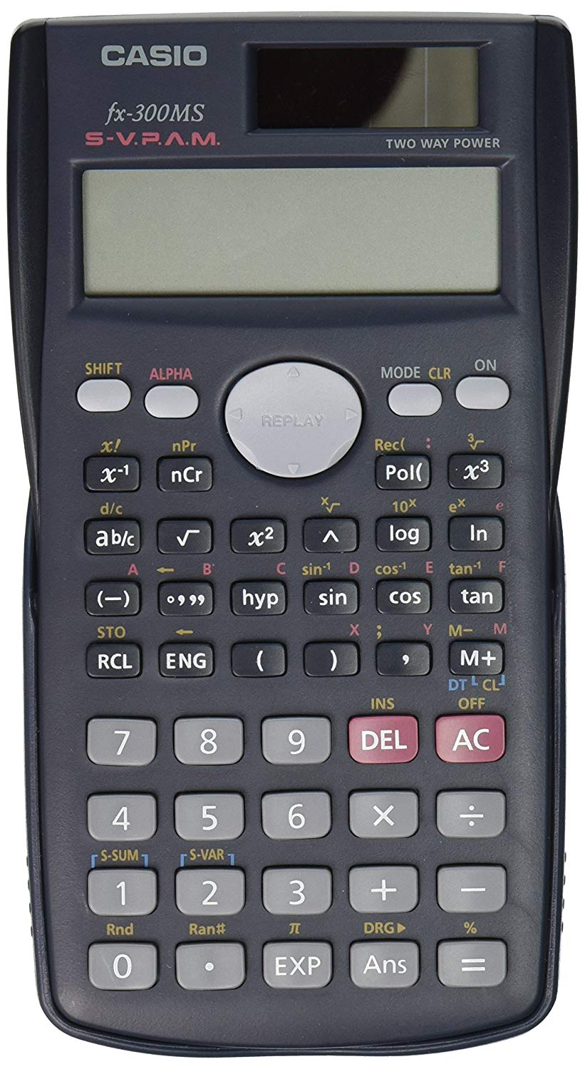
Basics (overview)
Input
5 + 10
15
Output
Assignment
Boolean and arithmetic operations
Conditionals
Repeats (a.k.a Loops)

Slide 3
Variables
Variables are like buckets that store values
Variable names can have (a-z, A-Z, 0-9, _)
Variables can be assigned with “=”
Python variables don’t care about types
Dynamic language
One variable can store single or multiple values (containers)
Examples: abc, Abc123, abc_def, _abcd all work, but not 123abc

Slide 4
Data Types
Basic data types
Integer (int), e.g. 100, -50
Float (float), e.g. 3.141, 2e10
Boolean (bool), e.g. True, False
etc.
Containers
String (str), e.g. “Hello World!”
List (list), e.g. [5,3.4, “This is a string”]
Tuple (tuple), e.g. (2, 9.0, “This is another string”)
Dictionary (dict), e.g. {“apple”: “red”, “banana”: “yellow”}
etc.

Slide 5
Comments
Single-line comment (#) # this is a comment
Multi-line comment (“””) “”” This is a multi-line comment ... and it continues to the next line! “””

Slide 6
Arithmetic Operation
Addition (2 + 3 = 5)
Subtraction (2 - 3 = -1)
Multiplication (2 * 3 = 6)
Division (2 / 3 = 0.67)
Modulo (5 % 3 = 2)
Power (3 ** 2 = 9)

Slide 7
Boolean Operation
Comparison Operators
Equality (==), inequality (!=)
Greater than (>), greater equals (>=)
Lesser than (<), lesser equals (<=)
Logical Operators
not
and, or
is,is not, in, not in

Slide 8
Conditionals
if something: Do this else: Do that
if something: Do this elif some-other-thing: Do that else: Do the other that
Note: instead of curly braces (like in C++) python uses spaces and indentations
The something here has to be a boolean

Slide 9
Loops
For Loop
fruits = [“apple”, “banana”, “orange”]
for fruit in fruits:
print(“I like”, fruit)
Result:
I like apple
I like banana
I like orange

Slide 10
For Loop & range function
range(from, to)
range(5, 20)

Slide 11
Loops
While Loop
counter = 1
while counter < 4:
print(counter, “squared is”, counter ** 2)
counter = counter + 1
Result: 1 squared is 1
2 squared is 4
3 squared is 9

Slide 12
Loop modifiers
Break
Break out of a loop immediately
Once break is hit, any code after the statement is not executed for the current iteration
Continue
Repeat the loop instantly
Once continue is hit, any code after the statement is not executed for the current iteration

